Slide 1
Journal Club
21. April 2023
Deep-Neural-Network Discrimination of Multiplexed Superconducting-Qubit States
B. Lienhard et.al (MIT)

Slide 2
Abstract
Demonstrating a quantum computational advantage will require high-fidelity control and readout of multiqubit systems. As system size increases, multiplexed qubit readout becomes a practical necessity to limit the growth of resource overhead. Many contemporary qubit-state discriminators presume single-qubit operating conditions or require considerable computational effort, limiting their potential extensibility. Here, we present multiqubit readout using neural networks as state discriminators. We compare our
approach to contemporary methods employed on a quantum device with five superconducting qubits and frequency-multiplexed readout. We find that fully connected feedforward neural networks increase the qubit-state-assignment fidelity for our system. Relative to contemporary discriminators, the assignment error rate is reduced by up to 25% due to the compensation of system-dependent nonidealities such as readout crosstalk, which is reduced by up to one order of magnitude. Our work demonstrates a poten- tially extensible building block for high-fidelity readout relevant to both near-term devices and future fault-tolerant systems.

Slide 3
Abstract
This Work
Five qubit multiplexed readout
Different methods of postprocessing
Most success with Neural Networks to eliminate crosstalk
Demonstrating a quantum computational advantage will require high-fidelity control and readout of multiqubit systems. As system size increases, multiplexed qubit readout becomes a practical necessity to limit the growth of resource overhead. Many contemporary qubit-state discriminators presume single-qubit operating conditions or require considerable computational effort, limiting their potential extensibility. Here, we present multiqubit readout using neural networks as state discriminators. We compare our
approach to contemporary methods employed on a quantum device with five superconducting qubits and frequency-multiplexed readout. We find that fully connected feedforward neural networks increase the qubit-state-assignment fidelity for our system. Relative to contemporary discriminators, the assignment error rate is reduced by up to 25% due to the compensation of system-dependent nonidealities such as readout crosstalk, which is reduced by up to one order of magnitude. Our work demonstrates a poten- tially extensible building block for high-fidelity readout relevant to both near-term devices and future fault-tolerant systems.

Slide 4
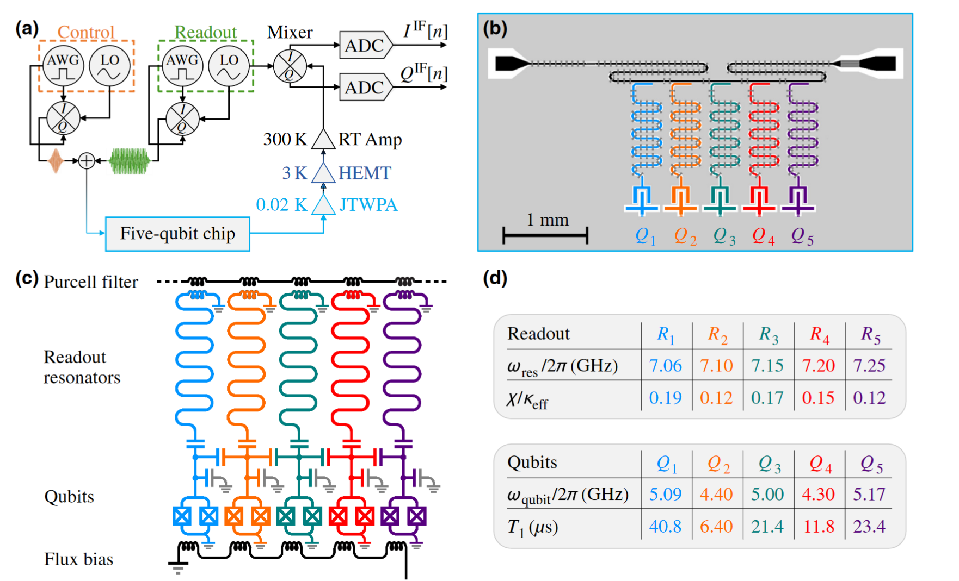
System

Slide 5
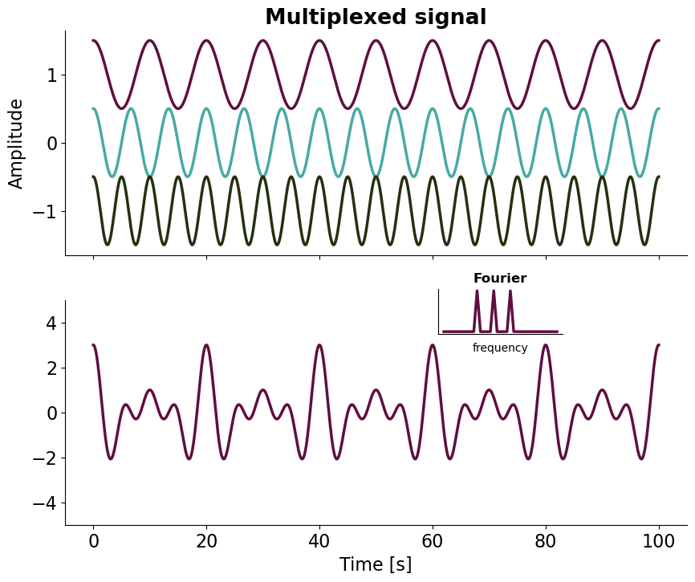
Multiplexed Signal

Slide 6
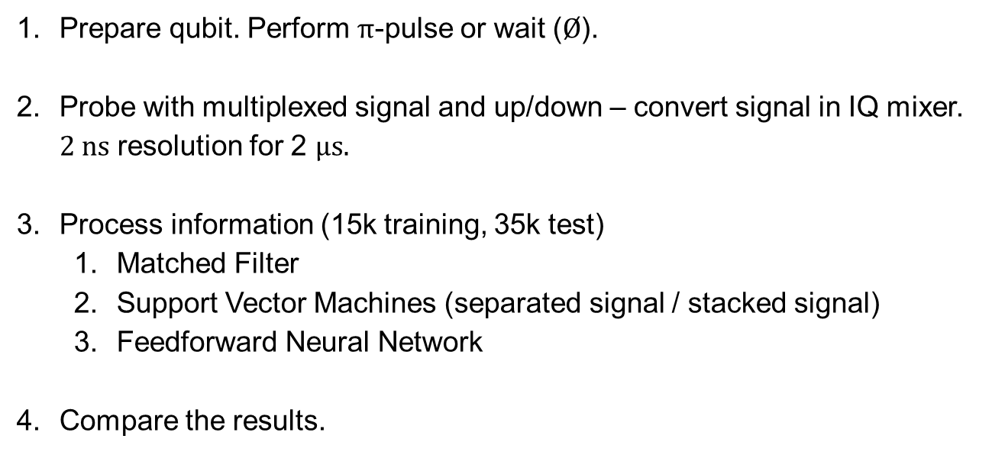
Experiment
Prepare qubit. Perform $π$-pulse or wait ($Ø$).
Probe with multiplexed signal and up/down – convert signal in IQ mixer. $2 ns$ resolution for 2 $μs.$
Process information (15k training, 35k test)
Matched Filter
Support Vector Machines (separated signal / stacked signal)
Feedforward Neural Network
Compare the results.

Slide 7
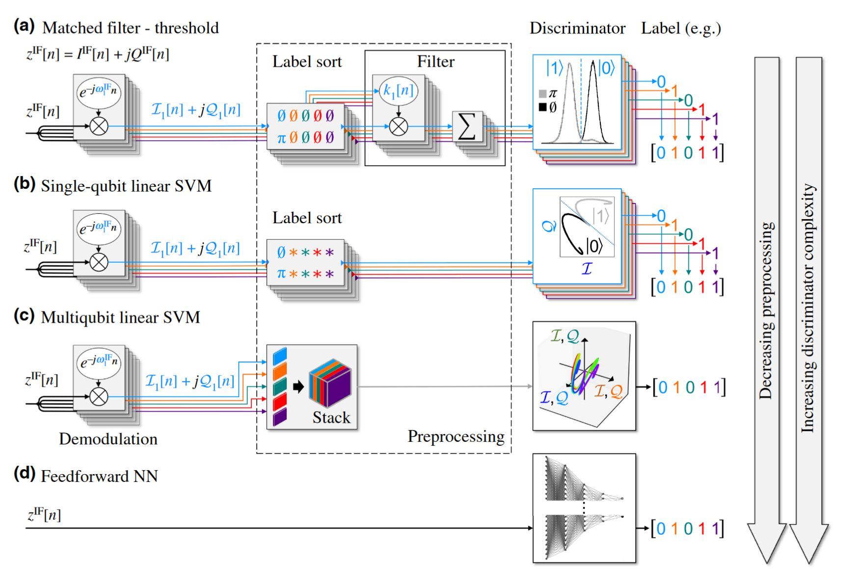
Methods for Processing

Slide 8
Methods for Processing
Demodulation
Split signals depending on frequency to represent the qubits

Slide 9
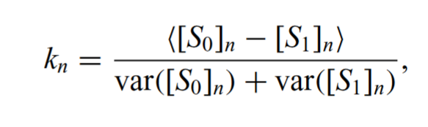
Methods for Processing
Matched Filter
Linear weights to best separate a sum of the trajectories

Slide 10
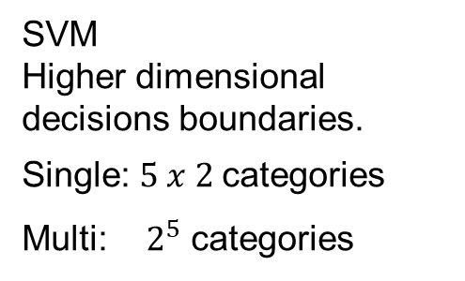
Methods for Processing
SVM
Higher dimensional decisions boundaries.
Single: $5 x 2$categories
Multi: $2^{5}$ categories

Slide 11
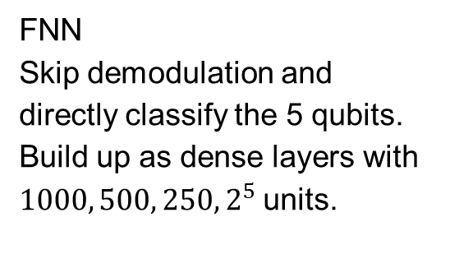
Methods for Processing
FNN
Skip demodulation and directly classify the 5 qubits.
Build up as dense layers with $1000, 500, 250, 2^{5}$units.

Slide 12
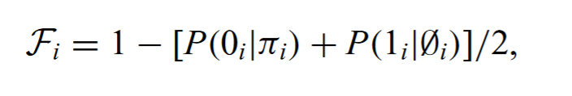
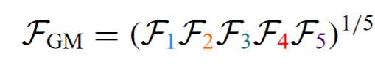
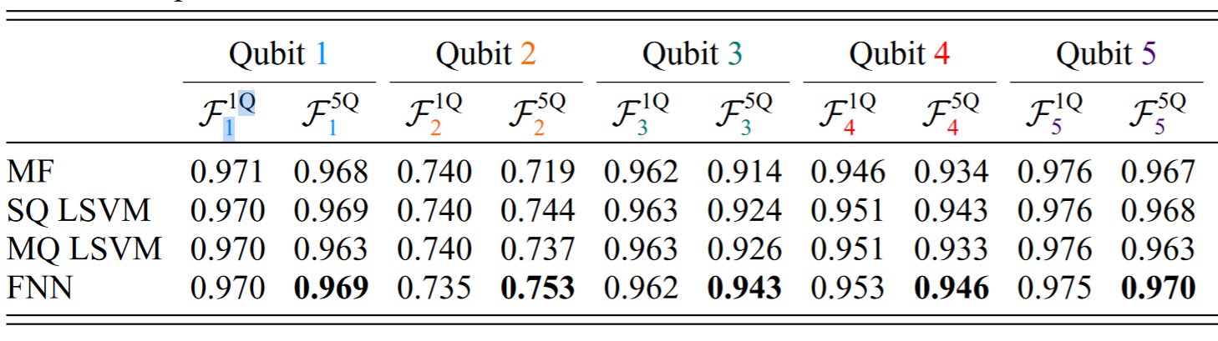
Results – Readout Fidelity
Highlights:
FNN performs the best when considering 5 qubits.
Almost tied for single qubit readout

Slide 13
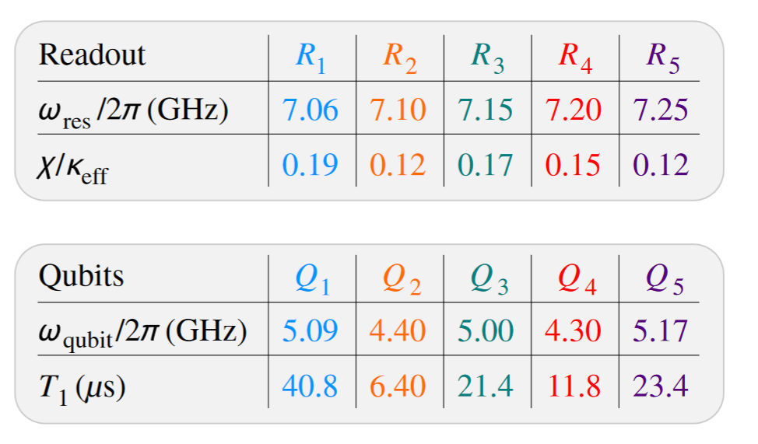
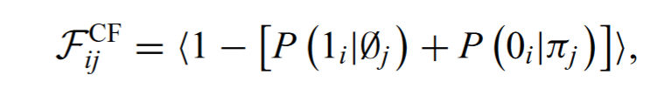
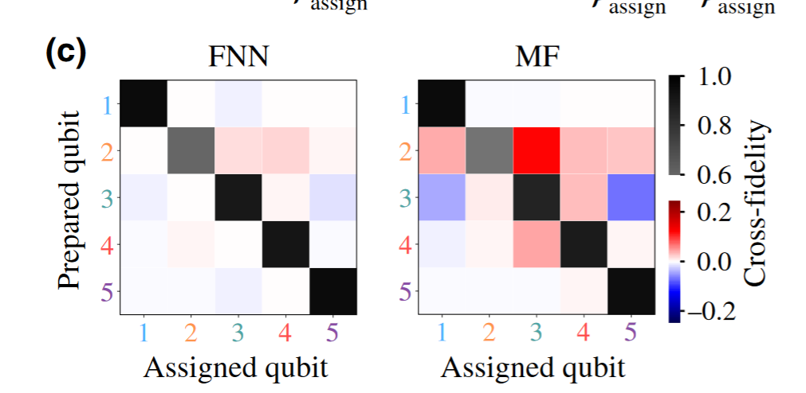
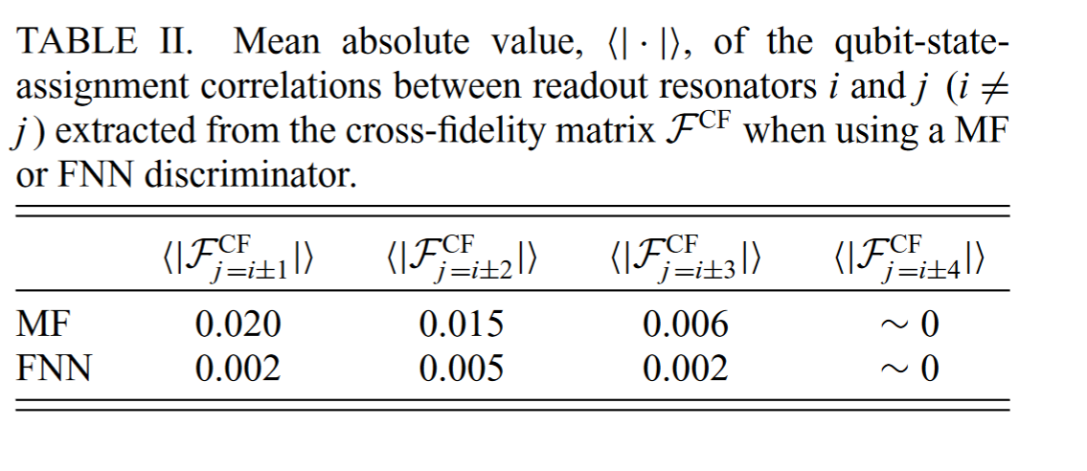
Results – Cross-Fidelity
0 if uncorrelated

Slide 14
Conclusions
Multiplexed qubit readout is somewhat limited by cross talk
Neural Networks can decrease the cross talk between resonators (space and frequency)

